Slide 1

Essentials of Economics
Seventh Edition
Chapter 7
Consumer Choice and Elasticity
Copyright © 2021, 2019, 2017 Pearson Education, Inc. All Rights Reserved.
Notes:
If this PowerPoint presentation contains mathematical equations, you may need to check that your computer has the following installed:
1) MathType Plugin
2) Math Player (free versions available)
3) NVDA Reader (free versions available)

Slide 2
Chapter Outline
7.1 Utility and Consumer Decision Making
7.5 The Price Elasticity of Demand and Its Measurement
7.6 The Determinants of the Price Elasticity of Demand
7.7 The Relationship between Price Elasticity of Demand and Total Revenue

Slide 3
Utility
Economists refer to the enjoyment or satisfaction that people receive from consuming goods and services as utility.
Utility cannot be directly measured, but for now, suppose that it could. What would we see?
As people consumed more of an item (say, pizza) their total utility would change.
The change in total utility a person receives when consuming one additional unit of a good or service is called the marginal utility (MU).
Remember: in economics, “marginal” means “additional”.

Slide 4
The Principle of Diminishing Marginal Utility
We generally expect to see the first items consumed produce the most marginal utility, so that subsequent items give diminishing marginal utility.
Law of diminishing marginal utility: The principle that consumers experience diminishing additional satisfaction as they consume more of a good or service during a given period of time.
SKIP TO SECTION 7.5 HERE. THIS IS BECAUSE THIS COURSE COVERS ONLY THE ESSENTIALS OF MICRO AND MACROECONOMICS.

Slide 5
7.5 The Price Elasticity of Demand and Its Measurement
Define and calculate price elasticity of demand.
As the price of sweetened beverages increase, we expect people will buy fewer of them. But how many fewer?
How can we come up with a sensible way to measure how much quantity changes when price changes?
One idea is to look at the slope of the demand curve.
But this won’t work, since the value of the slope depends on the units used to measure on the axes.
Instead, we define an elasticity, a measure of how much one economic variable response to changes in another economic variable, based on percentage changes in the variables.

Slide 6
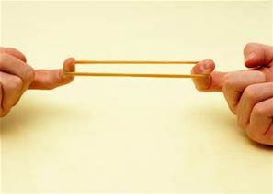
Price Elasticity of Demand
Our first elasticity to examine is the price elasticity of demand, the responsiveness of the quantity demanded to a change in price.
*WE WILL USE THE MID-POINT CALCULATION IN THIS CLASS.

Slide 7
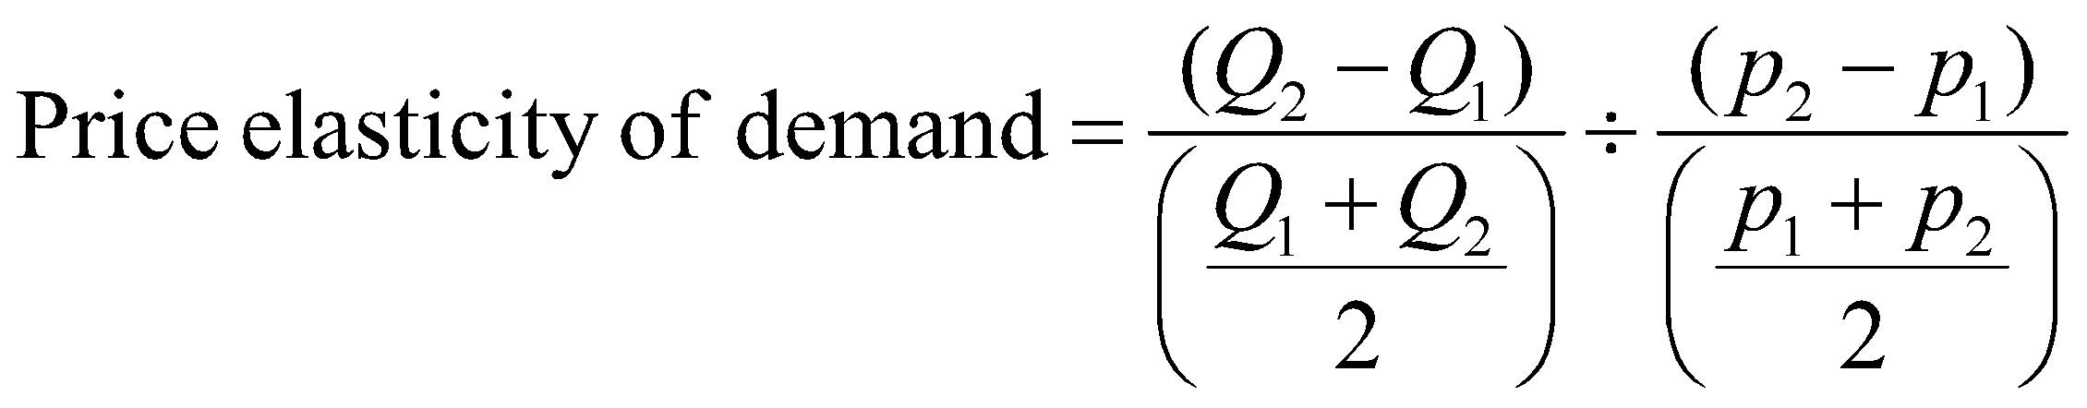
The Midpoint Formula for Elasticity
The midpoint formula avoids the confusion of whether we are going from A to B or from B to A: we use the average of A and B in the denominator instead of choosing one of them.
Price elasticity of demand becomes:
This first term is the percentage change in quantity, using the midpoint formula.
The second term is the percentage change in price, using the midpoint formula.

Slide 8
Observations about Elasticity
If the absolute value of the Price Elasticity of Demand is: | Then the Demand is:
greater than 1 | elastic
less than 1 | inelastic
equal to 1 | unit elastic
equal to infinity | perfectly elastic
equal to zero | perfectly inelastic

Slide 9
7.6 The Determinants of the Price Elasticity of Demand
List and explain the determinants of the price elasticity of demand.
Why do some goods have a high price elasticity of demand, while others have a low-price elasticity of demand?
Several characteristics of the good, of the market, etc. determine this.
The availability of close substitutes
If a product has more substitutes available, it will have more elastic demand.
Example: There are few substitutes for gasoline, so its price elasticity of demand is low.
Example: There are many substitutes for Nikes (Reeboks, Adidas, etc.), so their price elasticity of demand is high.

Slide 10
More Determinants of the Price Elasticity of Demand
The passage of time
Over time, people can adjust their buying habits more easily. Elasticity is higher in the long run than the short run.
Example: If the price of gasoline rises, it takes a while for people to adjust their gasoline consumption. How might they do that?
Buying a more fuel-efficient car
Moving closer to work
Whether the good is a luxury or a necessity
People are more flexible with luxuries than necessities, so price elasticity of demand is higher for luxuries.
Example: Many people consider milk and bread necessities; they will buy them every week almost regardless of the price.

Slide 11
Still More Determinants of the Price Elasticity of Demand
The definition of the market
The more narrowly defined the market, the more substitutes are available, and hence the more elastic is demand.
Example: You might believe there is no good substitute for jeans, so your demand for jeans is very inelastic.
But if you consider different brands of jeans, you might be more sensitive to the price of a particular brand.
The share of a good in a consumer’s budget
If a good is a small portion of your budget, you will likely not be very sensitive to its price.
Example: You might buy table salt once a year or less; changes in its price will not affect very much how much you buy.

Slide 12
The Relationship between Price Elasticity and Revenue
If demand is … | then … | because …
elastic | an increase in price reduces revenue | the decrease in quantity demanded is proportionally greater than the increase in price.
elastic | a decrease in price increases revenue | the increase in quantity demanded is proportionally greater than the decrease in price.
inelastic | an increase in price increases revenue | the decrease in quantity demanded is proportionally smaller than the increase in price.
inelastic | a decrease in price reduces revenue | the increase in quantity demanded is proportionally smaller than the decrease in price.
unit elastic | an increase in price does not affect revenue | the decrease in quantity demanded is proportionally the same as the increase in price.
unit elastic | a decrease in price does not affect revenue | the increase in quantity demanded is proportionally the same as the decrease in price.

Slide 13

Copyright

